Slide 1

Project:
FPT ACADEMY INTERNATIONAL FPT-APTECH COMPUTER EDUCATION
WEBSITE HARMONIC
Supervisor | Mr. Le Thanh Nhan
Semester | II
Patch | T1.2011.M0
Group | 2
No. | Full Name | Roll No.
1. | Dinh Ngoc Minh Hieu | Student1285592
2. | Nguyen Tran Hoang Phuc | Student1286085
3. | Van Khanh Phat | Student1275262
4. | Pham Tran Hoang Anh | Student1285593

Slide 2
Introduce
1.HARMONIC is a brand operating in the fashion industry established in October 2021 and is one of the leading prestigious men's/women's fashion brands in Vietnam.
2.HARMONIC always believes that fashion is the discovery and creation of HARMONIC's products, which are specifically designed with youthfulness and modernity to bring the most trendy fashion taste to young people. The product lines of HARMONIC are constantly diverse in style and design to extremely stylish fashion accessories, all creating a perfect, modern and stylish beauty for young people.
3.Besides, HARMONIC always puts itself in the mind and interests of customers to launch the best quality fashion products, extremely beautiful and novel designs but with extremely attractive and competitive prices.

Slide 3
PURPOSE
Customers are more and more inclined to look for what they need online, where everything is much cheaper due to low maintenance (unlike in a physical store where business owners have to worry about maintenance costs and money to rent).
Realizing that traditional marketing platforms would not support sales, HARMONIC decided to adopt an Internet approach as E-Commerce has become the fastest growing platform for businesses.
1
3
Whether the business of a business of a store goes up or not depends largely on the level of customer satisfaction and trust. Through the website, customers can have positive or negative feedback from which businesses can draw out shortcomings and adjust to match customer requirements and at the same time allow them to access and expand. their customer base.
Compared to the cost of building and operating a traditional store. Building an "online store" is considered more economical. Moreover, in the context of social distancing due to the Covid-19 pandemic, when businesses are struggling with store closures, the price of premises. Online sales websites are still operating effectively, bringing in revenue for businesses.
2
4

Slide 4
Customer's request
The website must allow customers visiting the website to browse and search for products by using search terms or filtering the categories and attributes of the products. They can compare products.
The site must allow administrators (store owners and others appointed to the job) to view, update (when required) existing products, categories, product attributes, orders, and more. order has been placed, customer feedback on the product....
In addition to managing products, categories, orders, and more, admins can also view reports on products, orders, and customers.
A customer can leave a review or inquiry about the product and review the product.
4

Slide 5
Roadmap General Functions
Customer can buy products
Admin can manage categories, product categories
Admin can manage order, customer, payment
1
3
5
2
4
6
Admin can manage products
Admin can manage slider homepage
Admin can manage ADMIN ACCOUNT

Slide 6
Specific Job Details Of Each Member

Slide 7
1 | Dinh Ngoc Minh Hieu | Admin | View Product | PRODUCT | 10/5/2021 | 10/25/2021 | 21
 |  |  | Insert/Edit/Delete Product |  | 10/5/2021 | 10/25/2021 | 21
 |  | Customer | View Product |  | 10/5/2021 | 10/25/2021 | 21
 |  |  | View Detail Product |  | 10/5/2021 | 10/25/2021 | 21
 |  |  | Add Proudct |  | 10/5/2021 | 10/5/2021 | 21
 |  | Admin | Insert/Edit/Delete Product Categories | CATEGORIES | 10/5/2021 | 10/5/2021 | 21
 |  | Customer | View Categories |  | 10/5/2021 | 10/25/2021 | 21
3 | Van Khanh Phat | Admin | View/Delete Customer Order | CUSTOMER ORDER | 10/5/2021 | 10/25/2021 | 21
 |  | Customer | Making order |  | 10/5/2021 | 10/25/2021 | 21 21
 |  | Admin | View Slide | SLIDER | 10/5/2021 | 10/25/2021 | 21
 |  |  | Insert/Edit/Delete Slider |  | 10/5/2021 | 10/25/2021 | 21
 |  | Customer | View Slider |  | 10/5/2021 | 10/25/2021 | 21
 |  | Admin | N/A | CART | 10/5/2021 | 10/25/2021 | 21
 |  | Customer | View Add to cart |  | 10/5/2021 | 10/25/2021 | 21
2 | Nguyen Tran Hoang Phuc | Admin | View/Delete Customer | CUSTOMER | 10/5/2021 | 10/25/2021 | 21
 |  | Customer | Login/Register |  | 10/5/2021 | 10/25/2021 | 21
 |  |  | Edit Profile / Change Password |  | 10/5/2021 | 10/25/2021 | 21
 |  |  | Delete Account |  | 10/5/2021 | 10/25/2021 | 21
 |  | Admin | View Product Categories | PRODUCT CATEGORIES | 10/5/2021 | 10/25/2021 | 21
 |  |  | Insert/Edit/Delete Product Categories |  | 10/5/2021 | 10/25/2021 | 21
 |  | Customer | View Categories product |  | 10/5/2021 | 10/25/2021 | 21
4 | Pham Tran Hoang Anh | Admin | View/Insert/Edit/Delete Admin Account | ADMINS | 10/5/2021 | 10/25/2021 | 21
 |  | Admin | View payment/ Delete Payment | PAYMENT | 10/5/2021 | 10/25/2021 | 21
 |  | Customer | Confirm if payemnt |  | 10/5/2021 | 10/25/2021 | 21

Slide 8
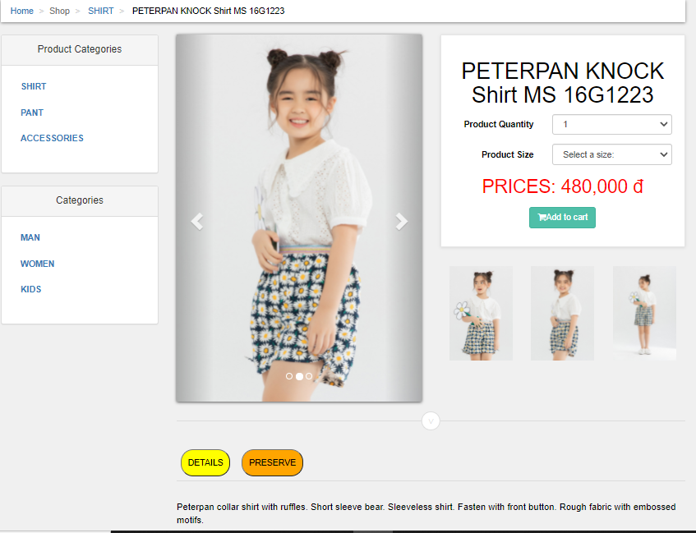
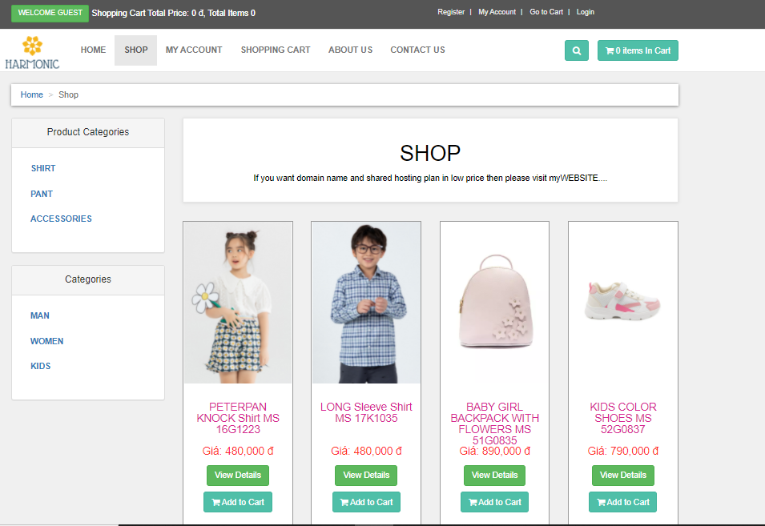
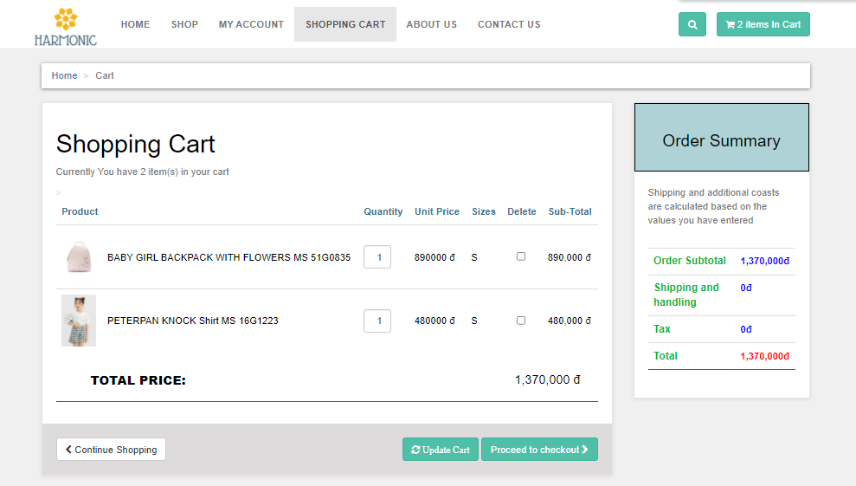
1/ PRODUCT & CART- DINH NGOC MINH HIEU
1.a. CUSTOMER
DINH NGOC MINH HIEU

Slide 9
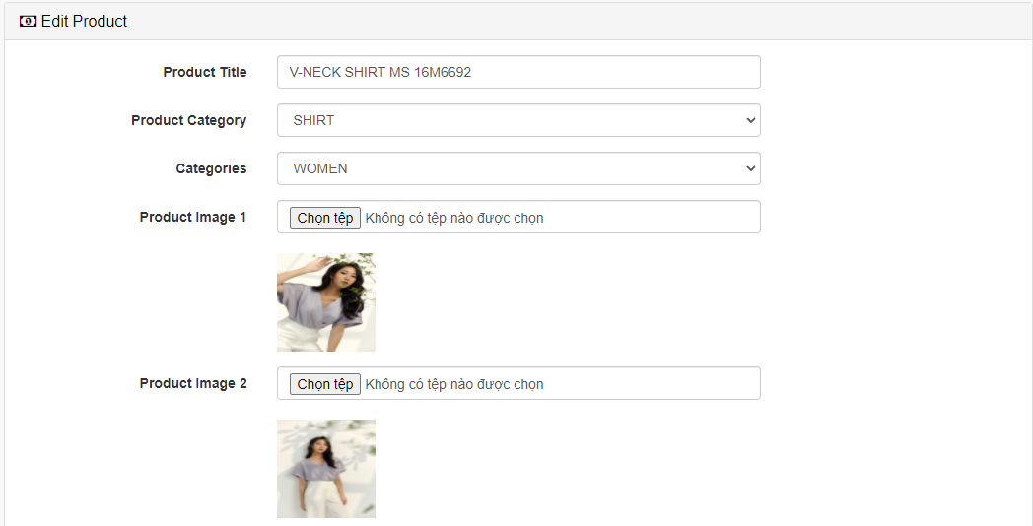
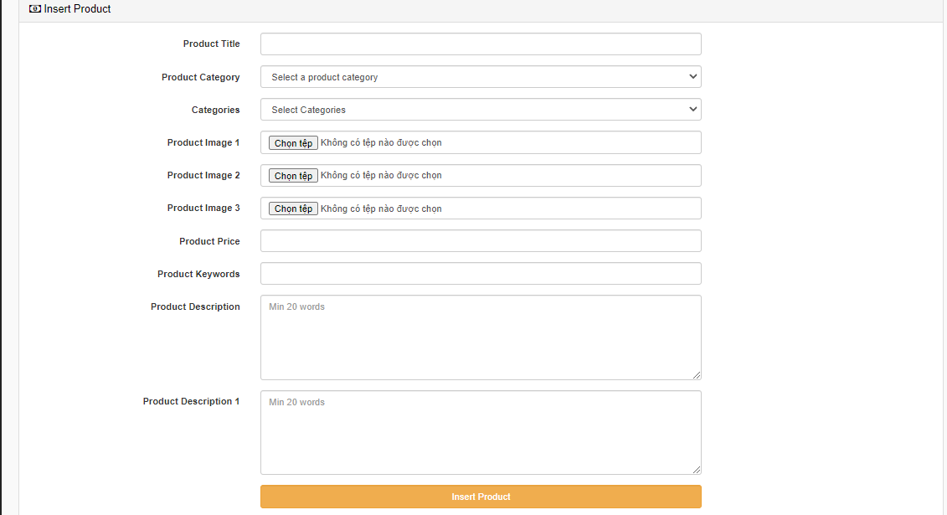
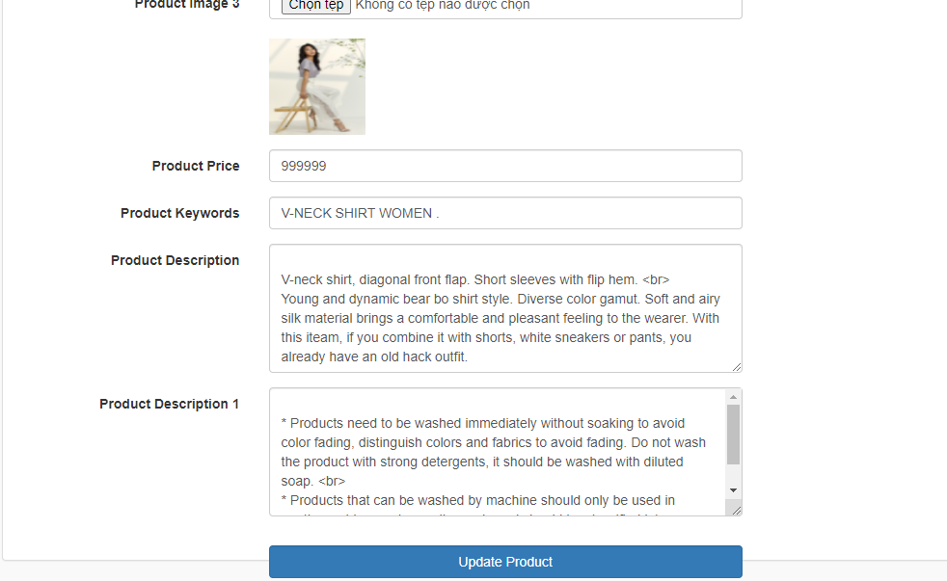
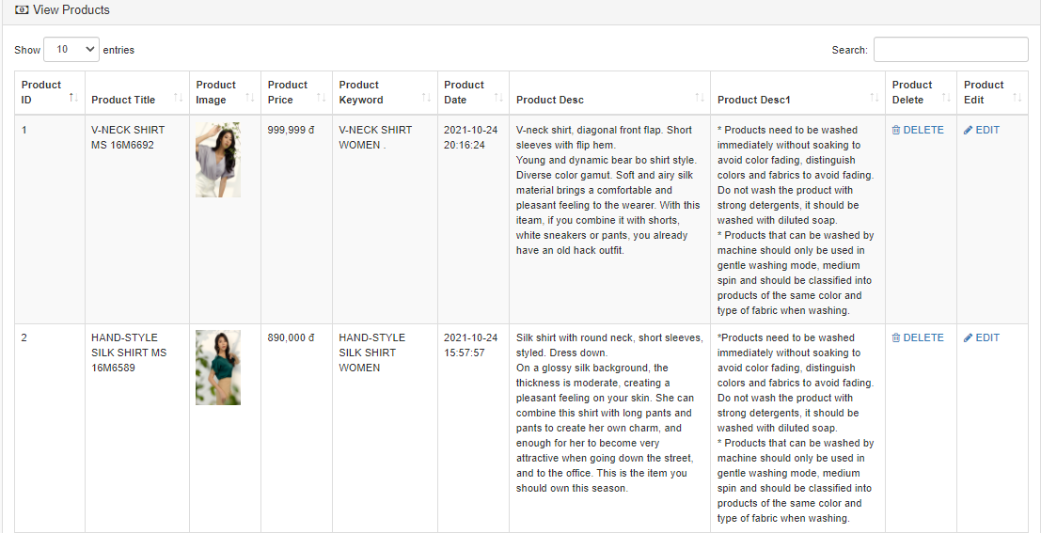
1/ PRODUCT & CART- DINH NGOC MINH HIEU
1.b.ADMIN
*PRODUCT
DINH NGOC MINH HIEU

Slide 10
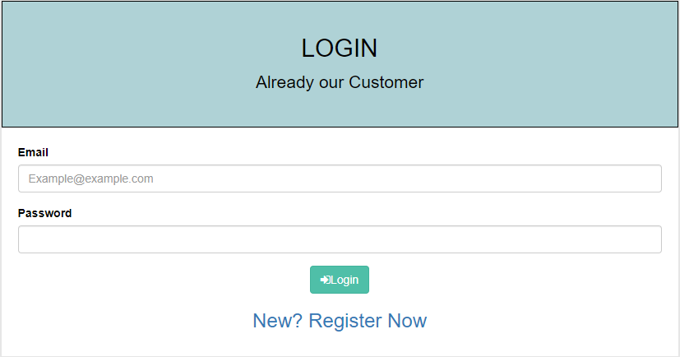
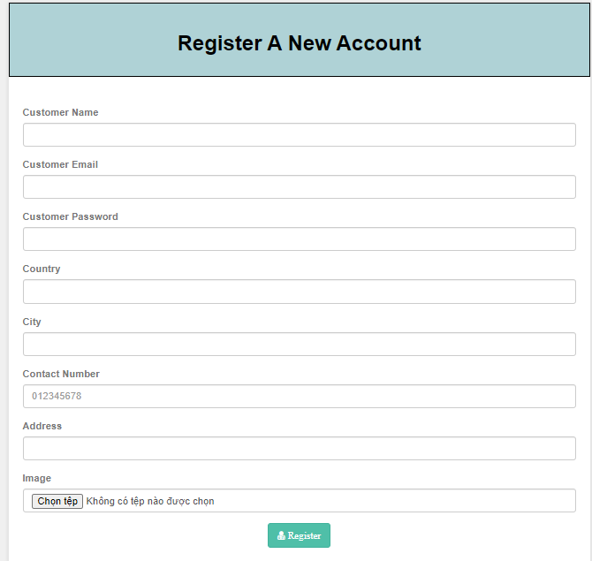
2/ CUSTOMER & PRODUCT CATEGORIES- NGUYEN TRAN HOANG PHUC
2.a. CUSTOMER
NGUYEN TRAN HOANG PHUC

Slide 11
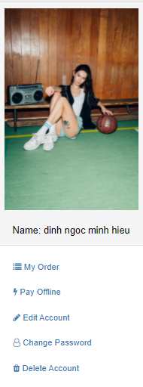
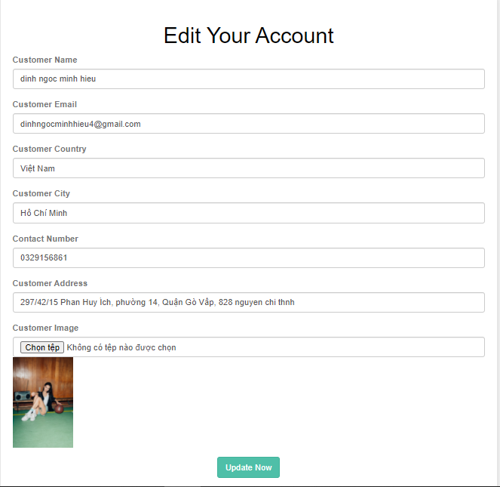
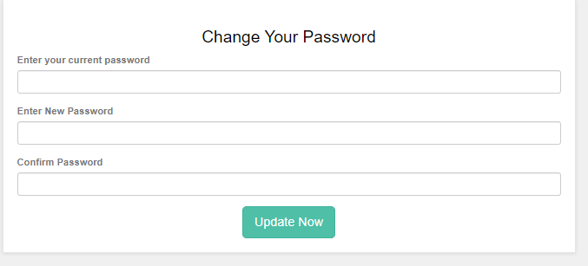
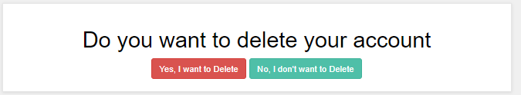
NGUYEN TRAN HOANG PHUC

Slide 12
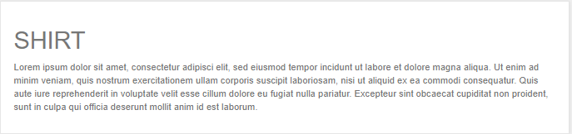
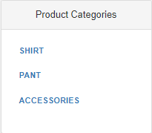
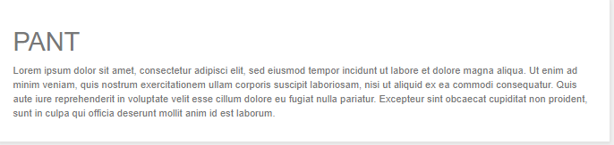
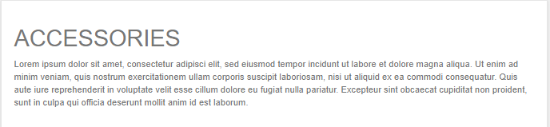
NGUYEN TRAN HOANG PHUC

Slide 13
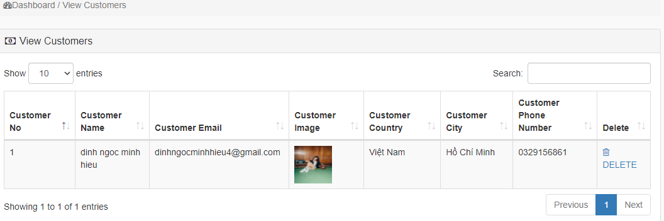
2/ CUSTOMER & PRODUCT CATEGORIES- NGUYEN TRAN HOANG PHUC
2.b. ADMIN
*CUSTOMER
NGUYEN TRAN HOANG PHUC

Slide 14
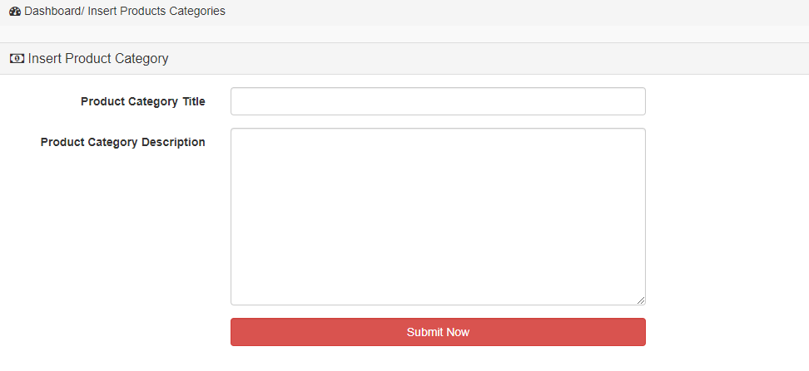
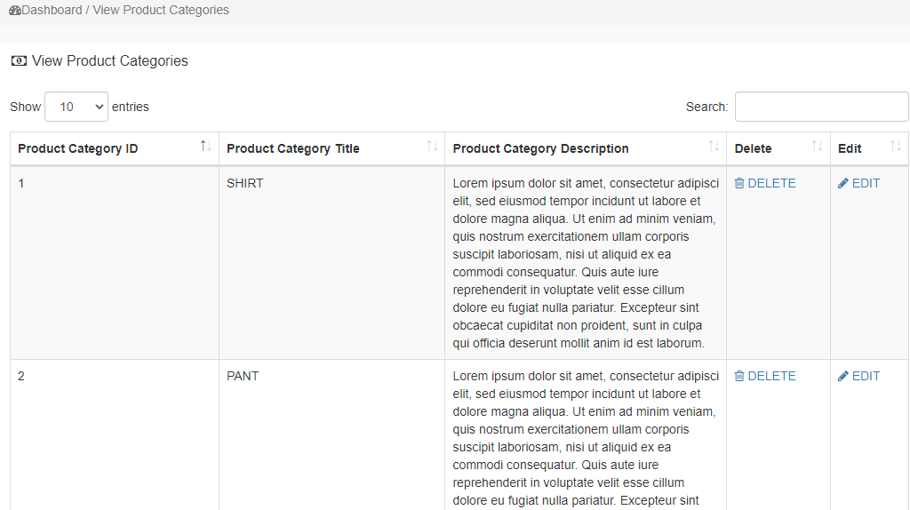
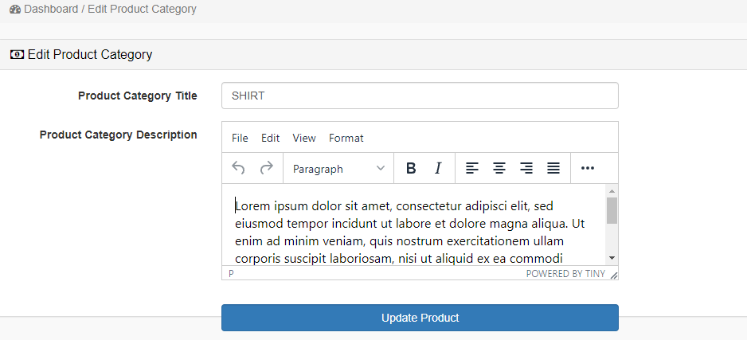
*PRODUCT CATEGORIES
NGUYEN TRAN HOANG PHUC

Slide 15
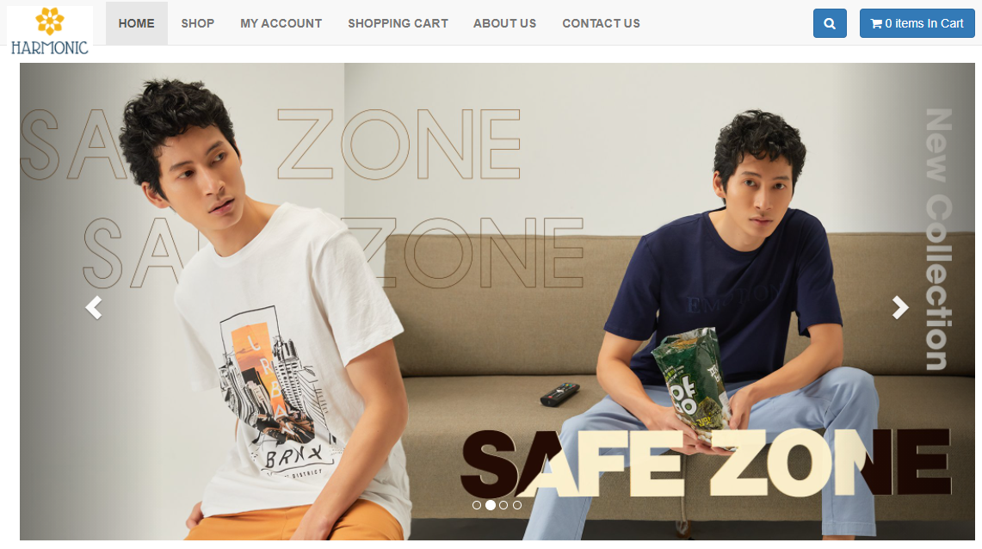
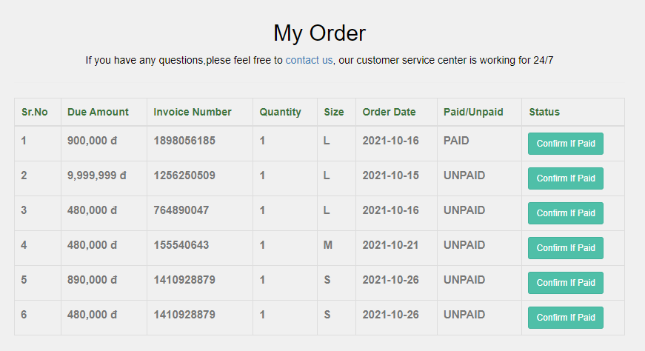
3/ CUSTOMER ORDER & SLIDE - VAN KHANH PHAT
3.a. CUSTOMER
VAN KHANH PHAT

Slide 16
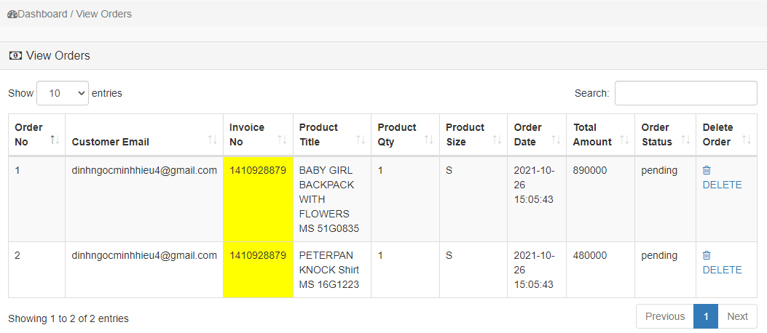
3/ CUSTOMER ORDER & SLIDE - VAN KHANH PHAT
3.b. ADMIN
*CUSTOMER ORDER
VAN KHANH PHAT

Slide 17
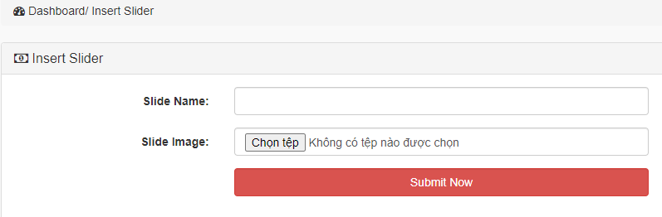
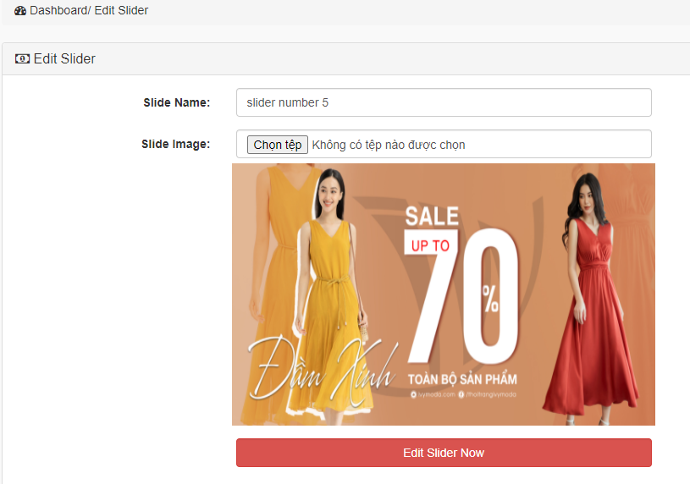
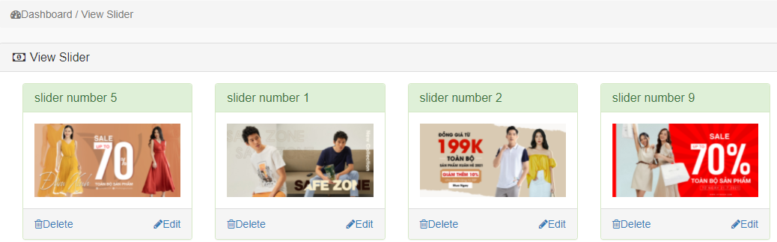
* SLIDE
VAN KHANH PHAT

Slide 18
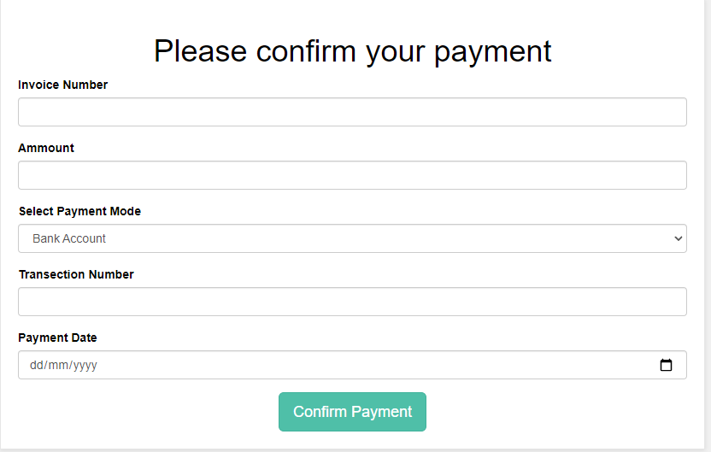
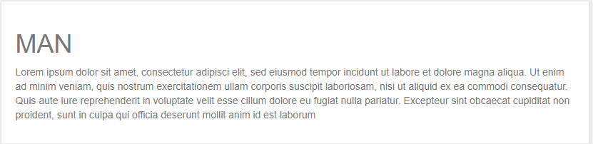
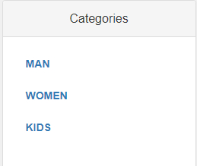
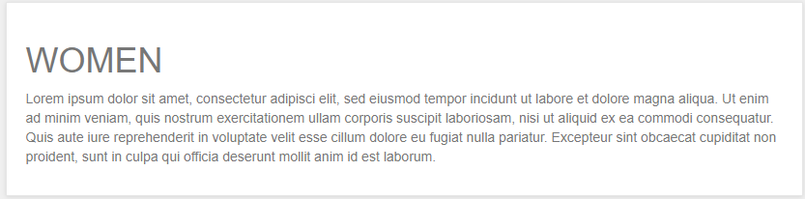
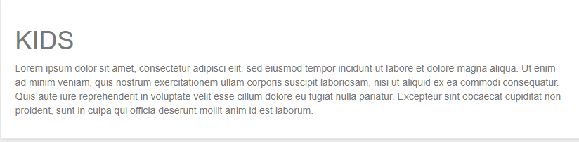
4/ PAYMENT, CATEGORIES,ADMIN – PHAM TRAN HOANG ANH
4.a. CUSTOMER
PHAM TRAN HOANG ANH

Slide 19
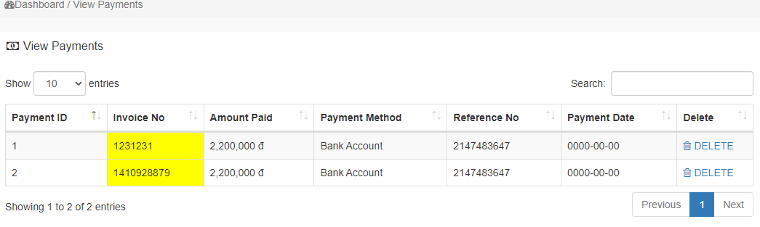
4/ PAYMENT, CATEGORIES, ADMIN – PHAM TRAN HOANG ANH
4.b. ADMIN
*PAYMENT
PHAM TRAN HOANG ANH

Slide 20
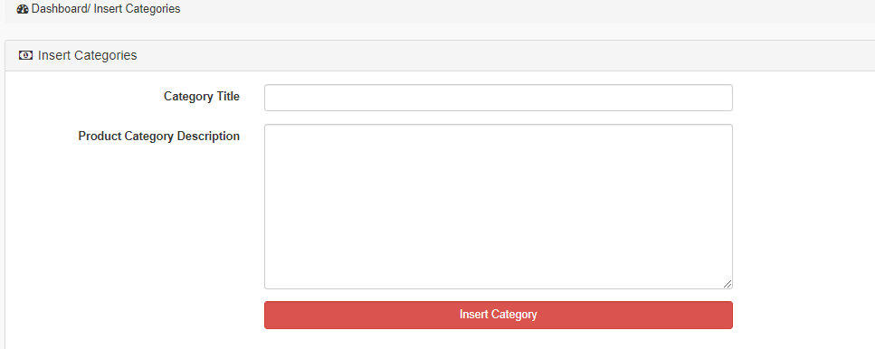
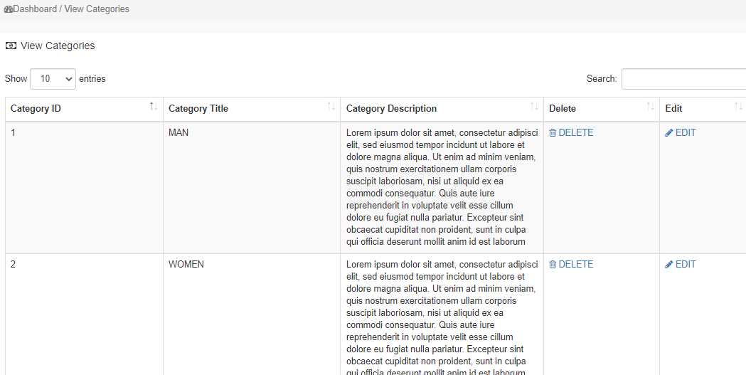
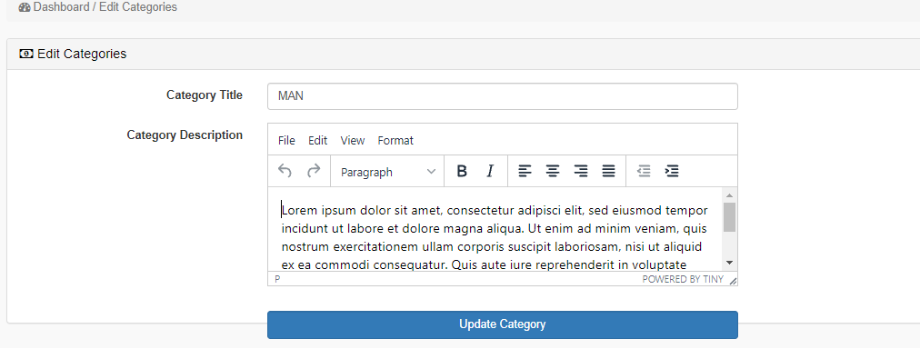
*CATEGORIES
PHAM TRAN HOANG ANH
20

Slide 21
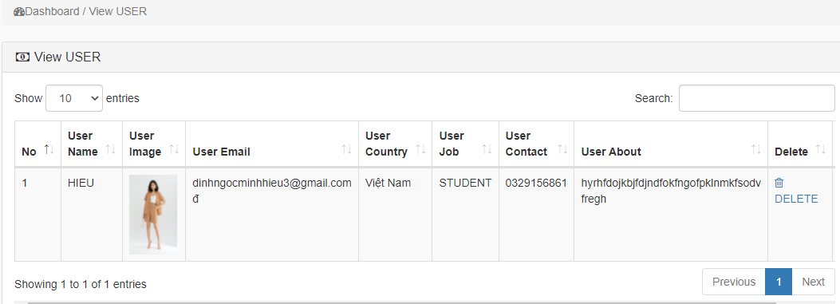
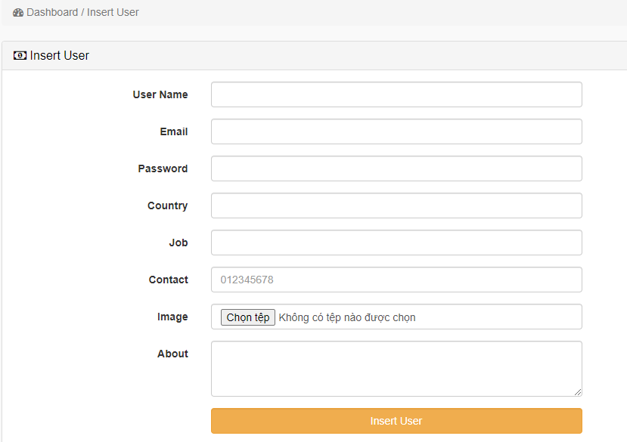
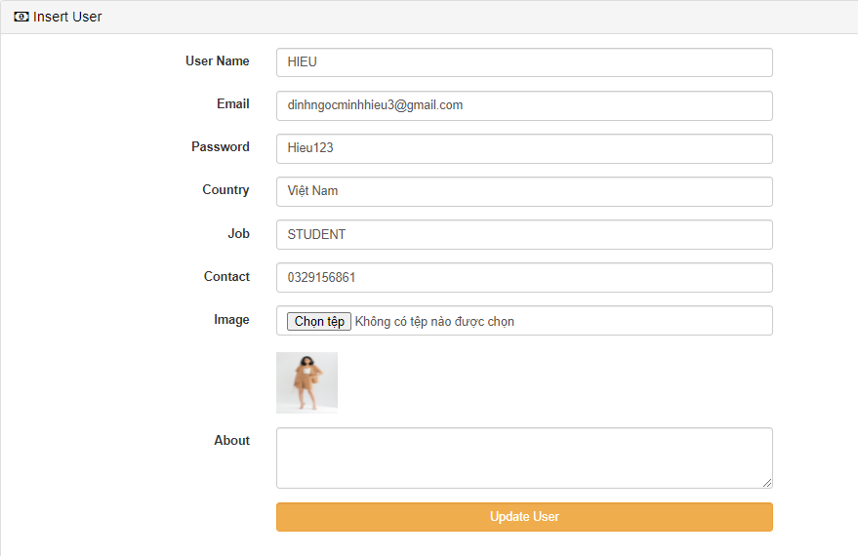
*ADMIN+
PHAM TRAN HOANG ANH

Slide 22
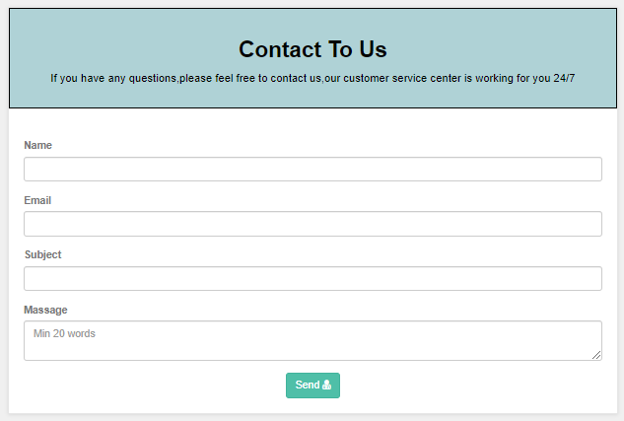
*CONTACT US
ALL MEMBER

Slide 23
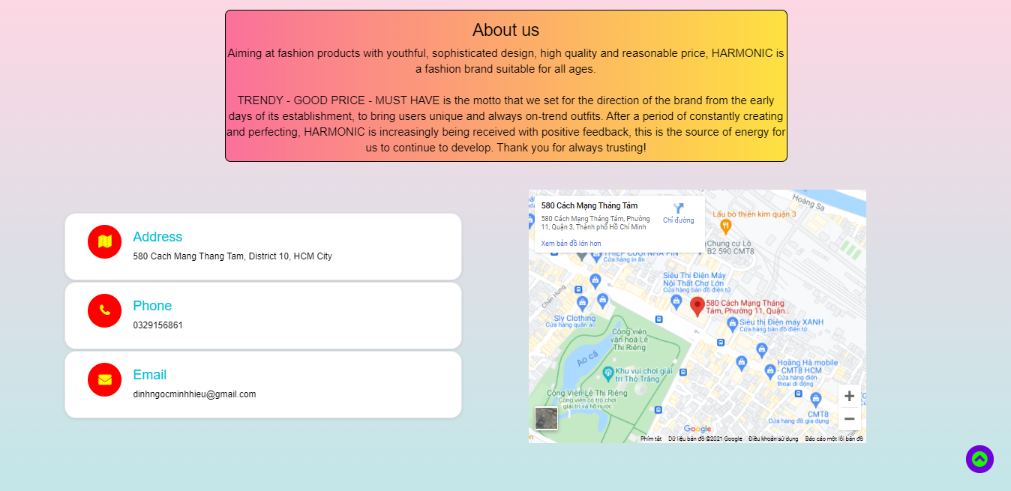

*ABOUT US
ALL MEMBER

Slide 24
Advantages of Website:
Customers can view details or overview and order fruits available on the website.
Customers can leave feedback for the store
Customers can also see the store's street address to visit or shop directly through the Contact section
It is possible to search specifically for the name of the fruit that the customer needs.

Slide 25
Cons of the website:
Because it is at the start-up stage, HARMONIC does not have a remuneration system as well as a membership registration function for loyal customers.
The interface is still incomplete and still has many flaws.
In the future, it will be necessary to try to develop more functions so that users can easily access and use the web in the best possible way.

Slide 26
THANK YOU
eProject : HARMONIC 2021

